Slide 1


RECOMMENDER SYSTEM CHALLENGE 2022-23
Alessandro Rossi - 10649607
Davide Zanutto - 10938003
Notes:
Good afternoon, this is our presentation about the recommender system challenge 2022/2023.

Slide 2
OUR PROCESS
TRIAL & ERROR
TUNING & TESTS
1° DEADLINE
2° DEADLINE
BEGINNING
BASIC HYBRID
MAIN PHASE
FINAL HYBRID
Trying to understand the dataset and which algorithms worked best
Tuning of hybrids and single algorithms to find the best combinations
One of our first hybrid recommenders: just slim elastic net & rp3Beta
Hybrid that worked best composed by 6 different algorithms
Notes:
Let’s start with a top-down view of the problem: this is a sketch of our process from the beginning to the end. At the beginning we did a lot of trial and error to try to understand the dataset and to understand which algorithms worked best for this problem.

Slide 3
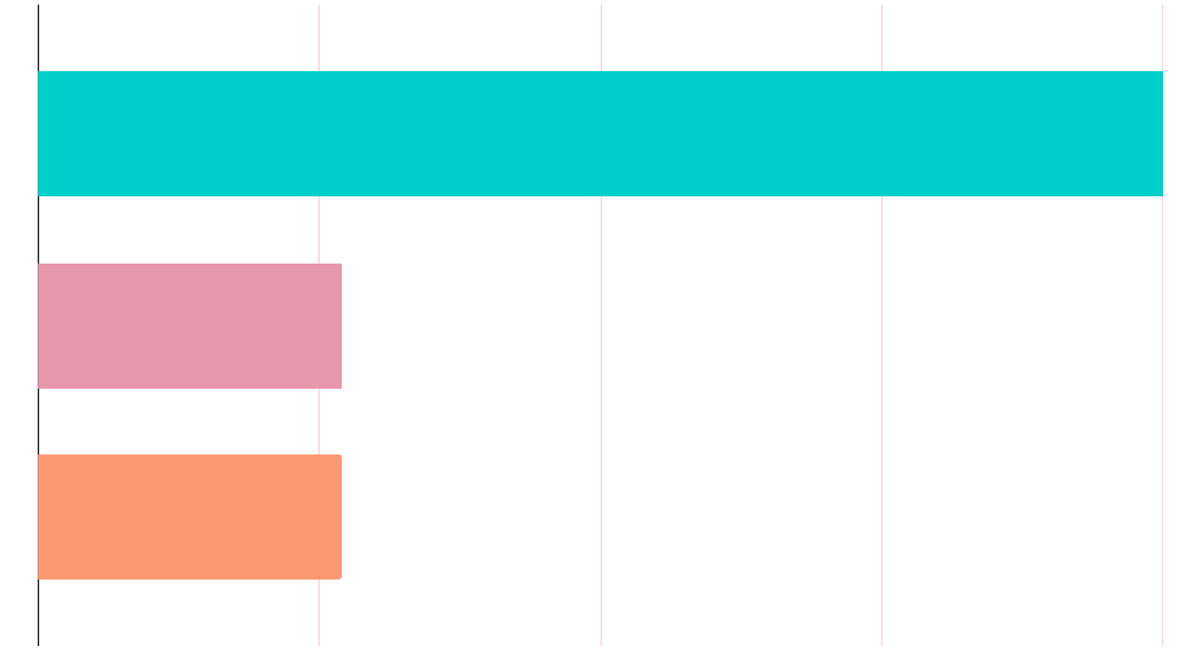
UNDERSTANDING THE DATA
URM
ICM Type
ICM Length
5.83M Interactions
41.6k Users
24.5k Items
233k Impressions
21.3k It.
Types of items
From 1 to 7
Not present for every item
21.3k It.
Number of series’ episodes
Not present for every item

Slide 4

BASE MODEL EVALUATIONS
Performances: Valid MAP@10
Where to start?
Convert user and interaction csv into a binary URM
Train-Validation Split (80:20)
Understand course’s repository
Start from simpler solutions
Don’t panic
SLIM-EN
EASE_R
RP3_BETA
P3ALPHA
Map@10:
0.036425
Map@10:
0.035487
Map@10:
0.033997
Map@10:
0.031520
01
02
03
04
ITEMKnnCF
IALS
SLIM-BPR
PureSVD
Our specs for the project
Used Kaggle’s integrated environment:
4 Core CPU
30 GB RAM
12 hours max execution time for CPU
P3ALPHA
Map@10:
0.031182
Map@10:
0.026376
Map@10:
0.025328
Map@10:
0.019294
Map@10:
0.031520
05
06
07
08
07

Slide 5




HYBRIDATION METHODS
STACKING
MERGING SIMILARITY MATRIX
ROUND ROBIN
PREDICTION COMBINATION
ICM type stacked vertically to the URM
With models that use the same structure
Combination of csv prediction files It didn’t go well…
Using a weighted average
Notes:
Similarity matrix merge: The merge is typically done by taking a weighted sum of the two matrices, where the weights are chosen to balance the contribution of the similarity matrix and the interaction matrix.

Slide 6
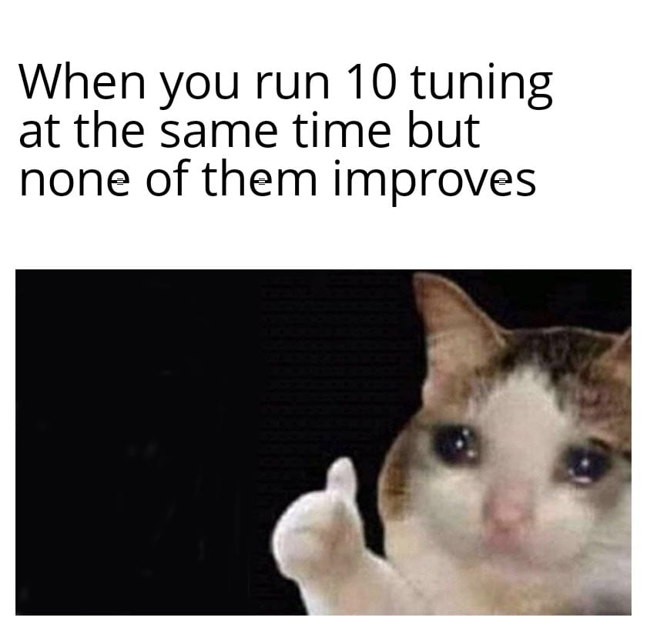
First Deadline Hybrid and Improvements
Improvement #1
Improvement #2
Improvement #3
Stacking ICM
TUNING
HYBRID MORE
FIRST DEADLINE HYBRID
Our first best hybrid was a similarity merge between SLIM-EN and RP3 beta
Unfortunately it was not enough to pass the last baseline so we were doing something wrong (or maybe we had been too much optimistic) So the next step was to understand what were we doing wrongly…
We noticed that some base models improve their performances by stacking the icm
By exploiting Kaggle’s potential we managed to run up to 20 different tuning at the same time
After the tuning phase we managed to pass the last baseline so we focused on improving our hybrid model
Notes:
Parla dello split dinamico

Slide 7
HYPERPARAMETER TUNING
RANDOM SEARCH
GRID SEARCH
BAYESIAN SEARCH
Fast but
not precise
Precise but
really slow
The best
Notes:
Bayesian optimization works better than grid search and random search because it uses a probabilistic model to model the function being optimized, which allows it to make more informed decisions about where to sample next. Grid search and random search, on the other hand, simply sample points randomly or on a pre-defined grid, which can be less efficient and may result in missing the global optimum. Additionally, Bayesian optimization also takes into account the uncertainty of the model to balance exploration and exploitation which results in a more efficient search.

Slide 8



OUR BEST HYBRID
Ease R
Slim Elastic Net
Ease R stacked
Slim EN stacked
Slim-EN St. + ItemKNN
ItemKNNCF
Final Hybrid
Implicit ALS
Stacking
Slim BPR
SlimBPR + Rp3Beta
Similarity matrix merge
RP3 Beta
Prediction combination

Slide 9
WHAT DIDN’T WORK
OUR FINAL RESULT
Building a not-binary URM exploiting information from ICMs
Some algorithms did good individually but bad when hybridized (Ex: P3Alpha)
List merging (Round Robin)
Using Top Popular recommendations for specific users
Stacking with ICM_length
Tailor different models for specific portions of the data
Thanks to the mentioned improvements and the final hybrid, we managed to reach an online map of: 0.06064 (private leaderboard)

Slide 10



OUR TEAM
Davide Zanutto
Alessandro Rossi
Data Science student
@ EIT Digital Master School (POLIMI, TU/e)
Data Science Student @ EIT Digital Master School (POLIMI, UPM)

Slide 11
THANK YOU
FOR YOUR ATTENTION

